Slide 1
communication of enterprise architecture

Slide 2
General
About the issues involved in the communication of enterprise architecture
The practical perspective presented a number of practical guidelines and conversation techniquess

Slide 3
communication of enterprise architecture
Describing architectures is all about communication:
  evolution, Business planning for new architecture, production, fielding, operation, and maintenance of a system, Preparation of acquisition documents…
  Each of these uses of architecture involves forms of communication

Slide 4
System Development as a Knowledge Transformation Process
It is important to identify the actors that can play a role in the communication that takes place during the system development process
System development community: a group of objects, such as actors and representations, which are involved in the development of a sytem.

Slide 5
System Development as a Knowledge Transformation Process
Concern: an interest of a stakeholder with regards to the architecture description of some system, resulting from the stakeholder’s goals, and the present or future role(s) played by the system in relation to these goals.
Ex:The requirements of a specific stakeholder with regards to the desired situation.

Slide 6
System Development as a Knowledge Transformation Process
The communication occurring within a system development community essentially is aimed at creating, furthering, and diseminating knowledge about system being developed.

Slide 7
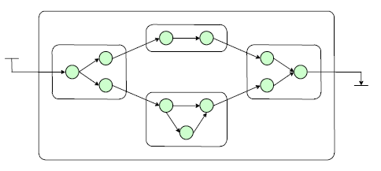
Conversation Strategies
The knowledge transformations as discussed in the previous section are brought about by conversations

Slide 8
Architectural Conversations
In architecture development, we find a number of common conversation techniques where it concerns the communication of architectural models:
      Brown-paper session
      Elicitation interview
      Workshop
      Validation interview
      Committing review…

